Slide 1
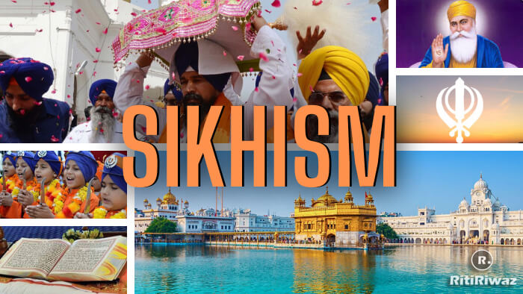

Slide 2
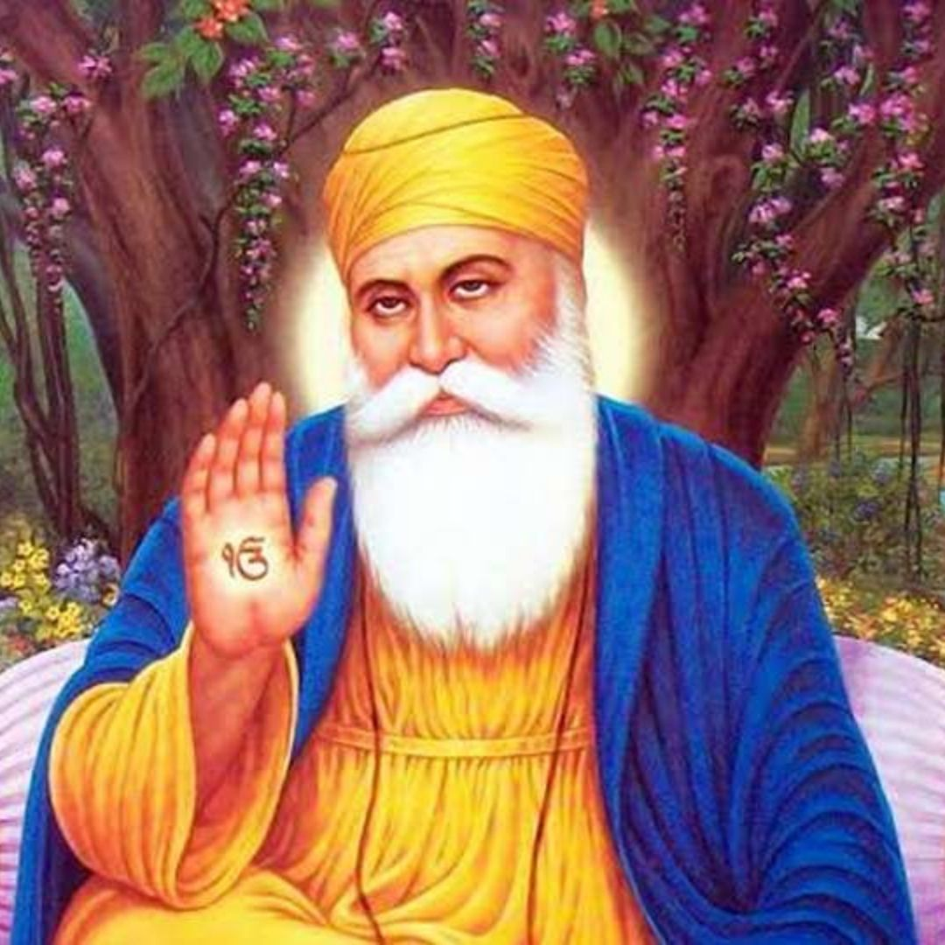
The Beginning
Sikhism was founded by Guru Nanak DevJi around 550 years ago in a place called the Punjab (India).

Slide 3
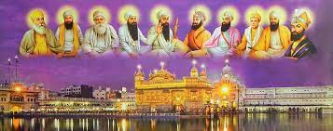
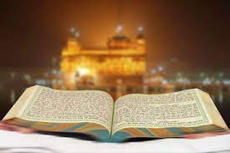
Facts About Sikhism
Sikhism is the 5th largest religion in the world.
Sikhism had 10 living Gurus in total (Beginning With Guru Nanak Devji).
The Guru Granth Sahib is the Sikh holy book and 11th Guru.
Sikhs pray in the Gurdwara. Gurdwara means 'Gateway to the Guru'.
The Golden Temple in India is Sikhism’s Holiest Gurdwara.
The Golden Temple is made of (amongst other things) 500kg of 22 Karat Gold.
All Gurdwara’s serve Langar (Free Meals) to everyone no matter what religion they belong to!
At the Golden Temple alone, around one hundred thousand people visit the langar every day and the number increases on weekends and special days.

Slide 4

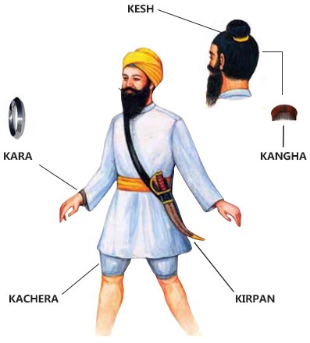
A Few More Images of Sikhism
The 1st picture is of a Khanda which is a symbol of Sikhism.
The 2nd picture is of the 5 Ks which all Sikhs who are religious must have.

Slide 5
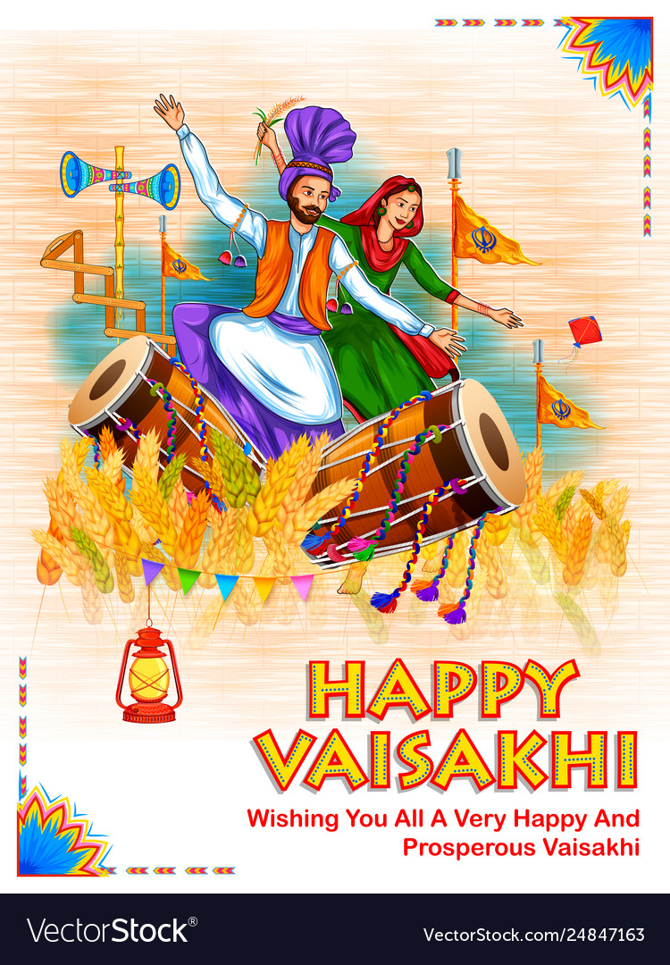
Vaisakhi - the Sikh New Year festival - is one of the most important dates in the Sikh calendar. It marks the start of the Punjabi New Year, but it is also a day to celebrate - 1699 - the year when the Khalsa was formed.

Slide 6
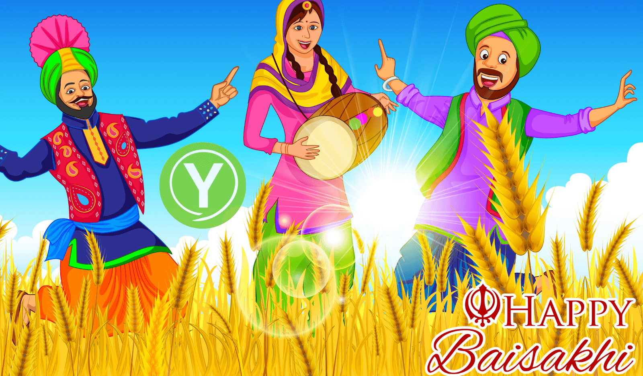
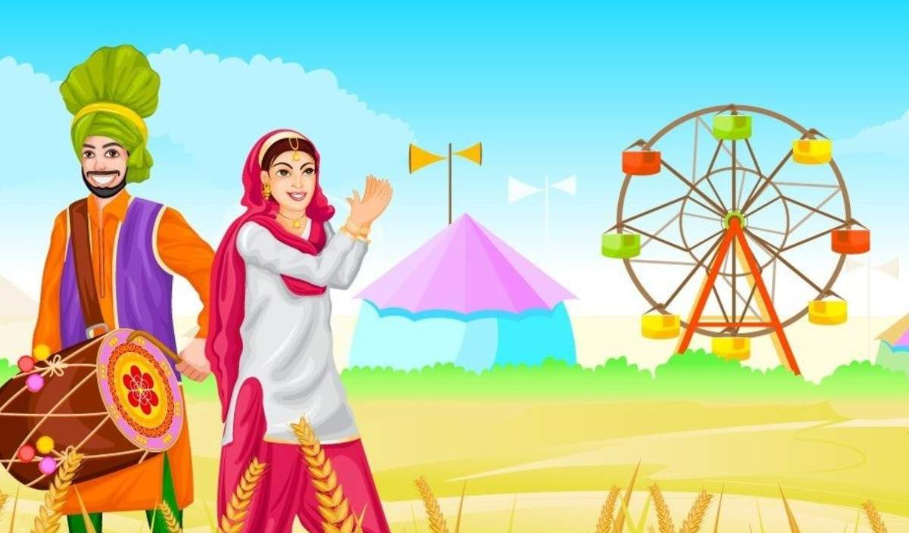
The Origins of Vaisakhi (Also Spelt Baisakhi)
On 13th or 14th April each year, the whole of Punjab and many parts of Northern India will gear up to celebrate the harvest festival of Vaisakhi. On this joyful day, the farmers offer their prayers in thanks for a bountiful harvest. Across the country, people celebrate the Vaisakhi festival with a lot of fun, merriment and enthusiasm.

Slide 7
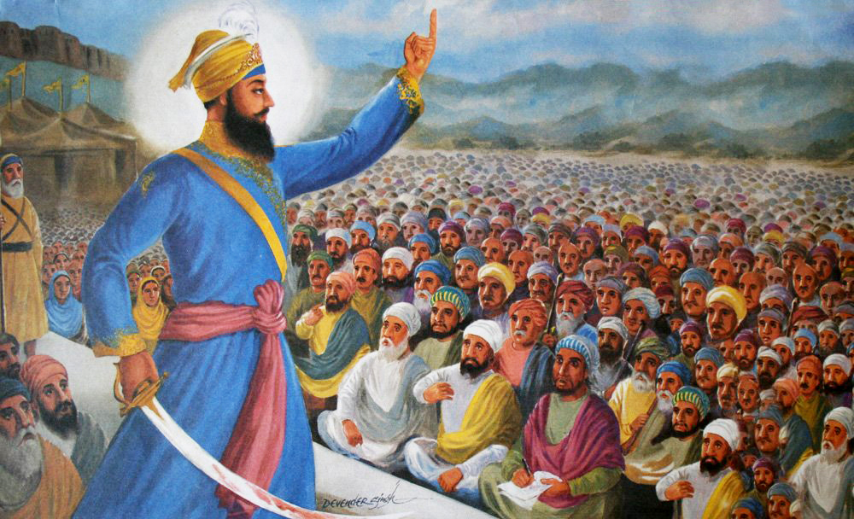
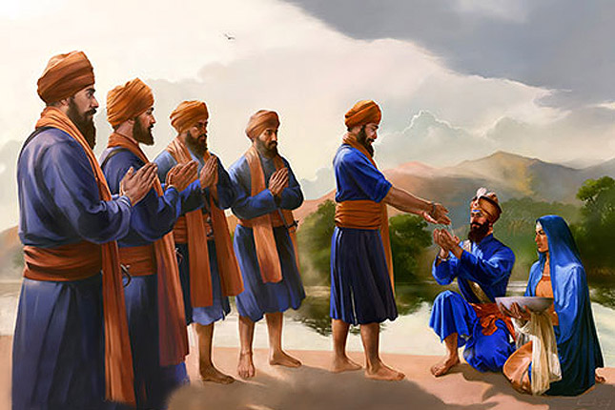
Origins of The Khalsa on Vaisakhi of 1699
The Khalsa tradition was initiated in 1699 by the Tenth Guru of Sikhism, Guru Gobind Singh. Its formation was a key event in the history of Sikhism. The founding of Khalsa is celebrated by Sikhs during the festival of Vaisakhi.

Slide 8

Videos On Vaisakhi
https://www.bbc.co.uk/bitesize/topics/zsjpyrd/articles/z6qqy9q
https://www.youtube.com/watch?v=QXiTfSzXbm0
https://www.youtube.com/watch?v=_fffDtJWUaM

