Slide 1
What is Anxiety?
A Presentation to help us understand anxiety and how we can manage it
Emma Lambdin
CAMHS Primary Mental Health Worker

Slide 2
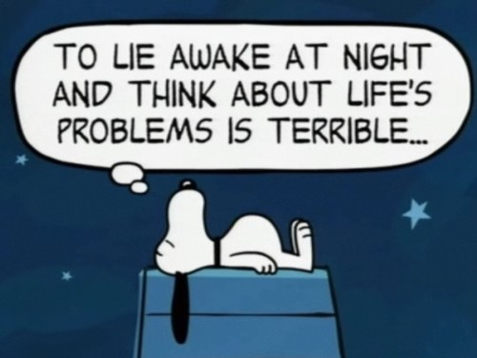
Aims and Objectives of the Session
Define anxiety: what does anxiety mean to you
Recognise triggers that can cause anxiety both in yourself as a parent and in your child
Recognise signs and symptoms of anxiety
Explain cycle of anxiety using a cognitive behavioural model
Explain how anxiety can be managed by exploring some helpful suggestions and solutions
Know where to go and get help if needed

Slide 3
Group Ground Rules
Health Warning!
What is said in the room stays in the room
Respect each other and each others views & feelings
Take turns to talk one at a time and listen to each other
Questions at the end
No Mobile Phones (please have on silent if needed for emergencies)
Any other ground rules?

Slide 4

Getting to know you
Turn to the person next to you and tell them your:
Name
Best hopes from today’s session
One interesting fact about yourself
How did that exercise make you feel?

Slide 5
What does ‘anxiety’ mean to you?

Slide 6
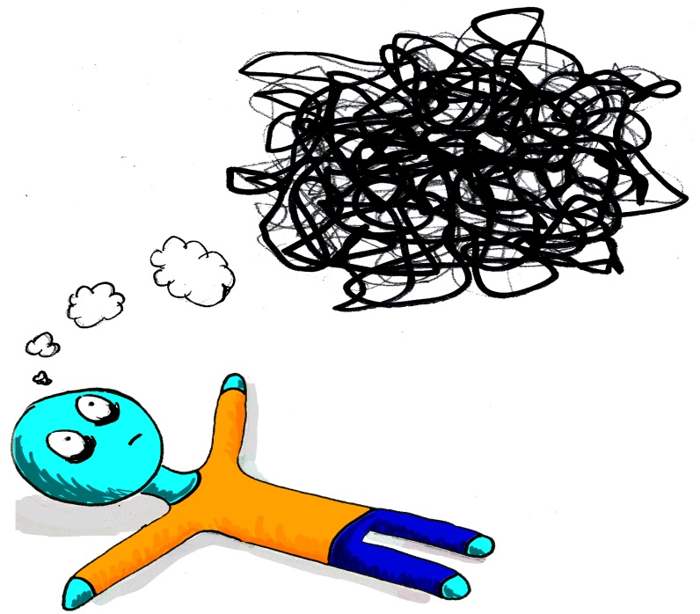
Definition of ANXIETY
‘Anxiety is a normal feeling which can feel abnormal and give an overwhelming sense of apprehension and fear often marked by physiological signs (as sweating, tension, and increased pulse), by doubt concerning the reality and nature of the threat, and by self-doubt about one's capacity to cope with it’
Notes:
Anxiety is like a ride on a static bike – your adrenalin surges, your heart rate races, your body sweats, your face goes red … but it doesn’t get you very far.

Slide 7
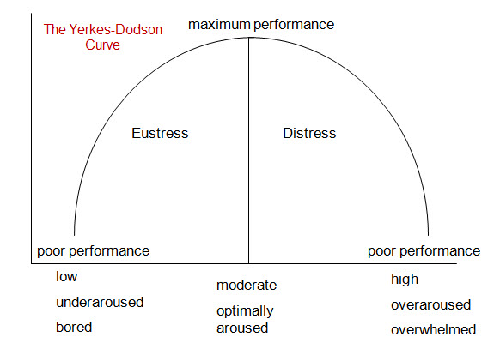
What is Anxiety?
Anxiety is an emotion.
Emotions are how our brains make sense of what is going on around us and move us into action.
Emotions are constantly shifting and changing in response to our situation.
Feeling anxious is normal and is part of every day life. You can feel anxious because you care and want to do well or when you have to do something new or different or challenging.
Learning to accept that we can feel anxious from time to time is key to learning to manage it.
Notes:
Anxiety is a natural part of life and something that everyone experiences at some stage.
Anxiety is an emotion and is a normal response to something dangerous or stressful. It becomes a problem when it shows up at unexpected times and takes a particularly firm hold. When anxiety is in full swing, it feels awful. Awful enough that anticipation of the feeling is enough in itself to cause anxiety.
As a parent you want to protect your child from the awful feeling of anxiety but the truth is you’ll never be able to get rid of everything that makes your child feel anxious or stressed.
Even if you could, it wouldn’t be helpful. But there are some things you can do to help ease your child’s worries, and encourage them to manage their own anxiety levels.
Most children are open to possibility of change, and very quick to make the right connections when they’re given the right information and support. As the adult in their life, you’re the perfect one to give it.

Slide 8



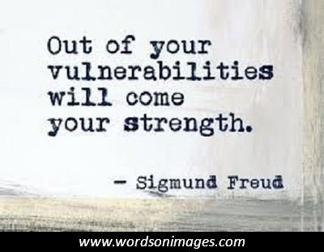
Anxiety is NORMAL
We all experience worry and anxiety at times.
It is completely normal to feel anxious when we experience something new for the first time.
Even famous people experience anxiety from time to time:
Sigmund Freud
Adele (singer)
Johnny Depp (actor)
Barbara Streisand (singer/actor)

Slide 9
So what is Normal worries ?
Age | Normal Fear
Birth- 6 Months | Loud noises, loss of physical support, rapid position changes, rapidly approaching other objects
7-12 Months | Strangers, looming objects, unexpected objects or unfamiliar people
1-5 Year | Strangers, storms, animals, dark, separation from parents, objects, machines loud noises, the toilet
6-12 Year | Supernatural, bodily injury, disease, burglars, failure, criticism, punishment
12-18 | Performance in school, peer scrutiny, appearance, performance
Notes:
So what is normal worries – there are lots of normal fears – child development books state the above – but as we are know we are now in the 21st century nothing is as it was in our time – children are exposed to poor parenting – more poverty – parental drug and alcohol - adult mental health – peer pressure – cyber bullying via social networking – haves and have not's – materialistic ethos with children

Slide 10
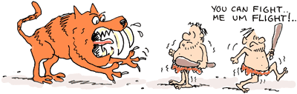
Where does Anxiety come from?
When our ancestors went out hunting for food they sometimes came across danger.
The danger would trigger an internal worry alarm system in the brain called the Fight or Flight response which is a defence mechanism wired into our brains to get us out of danger and stay safe.
Notes:
The most important step to controlling anxiety is understanding where it comes from and why it’s there.
When something is a threat, the human body is instantly and automatically readied to run for its life or fight for it. This response is the ‘fight or flight’ response and it has been hardwired into the human brain. ‘Fight or flight’ is a primitive response – all action and not a lot of thought. Reason and rationality are quite useless against it.
The human brain has perfected the response over thousands of years. Back in the days of cavemen, cavewomen and cave wild animals, humans needed a quick physical response to avoid being dinner. Fast forward to a time of doors, locks and no sabre tooth tigers, and the need for a physical response is significantly less.
Despite this, the part of the human brain that has been mastering the flight or fight response for thousands of years is still just as active and on guard as ever. It’s blind to the specifics of the threat, opting to act first and ask questions later
We are all wired to notice and respond to threats in the environment. When we notice something potentially dangerous, our body gets us ready to fight the danger or run from it. This is something that happens in all of us, and it’s a healthy, normal thing to do. It’s one of the things that has kept us humans alive, so when it’s happening in the right dose, it’s a great thing.

Slide 11
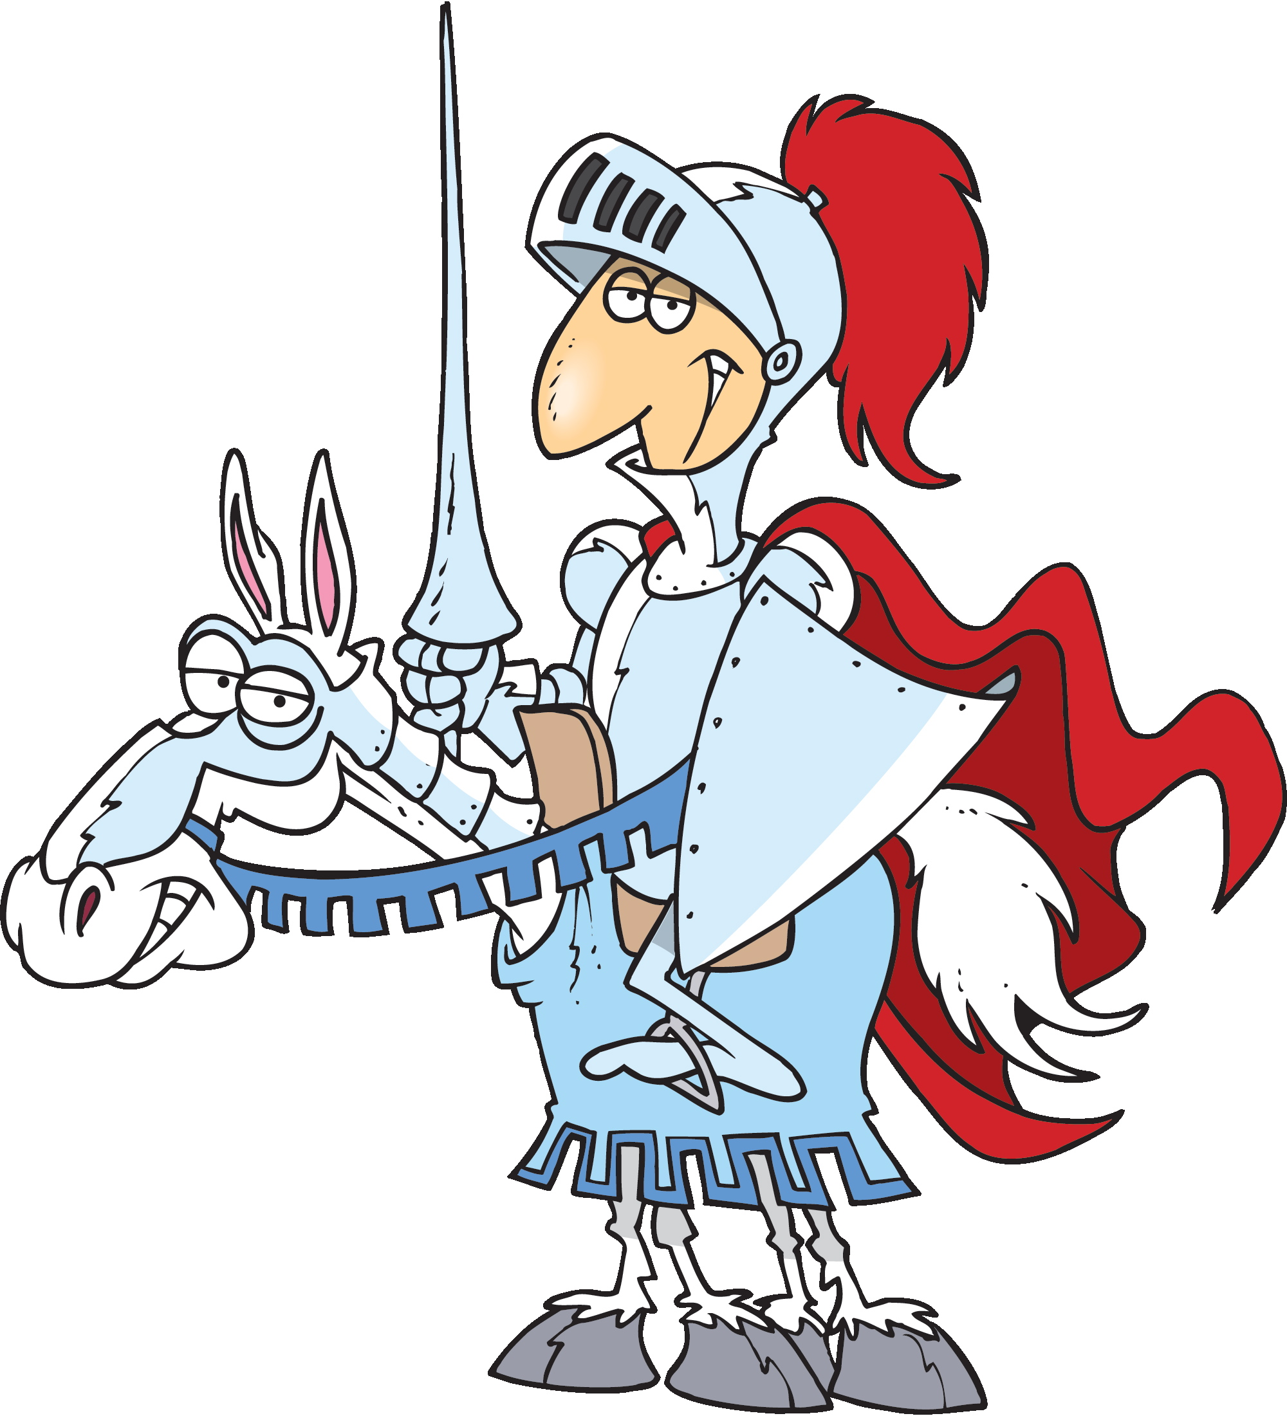
Anxiety is a Survival Mechanism
Anxiety is a survival mechanism that still plays a role in modern times.
This defence mechanism is a good thing. It is there to protect you.
It can get us out of dangerous situations.
It can give us a massive energy boost to help us escape or defend ourselves.

Slide 12
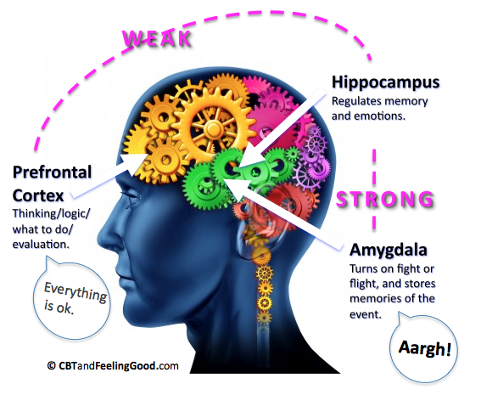
How Anxiety Works
Your brain is made up of two main parts:
Thinking brain (logical, rational, memory)
Feeling brain (emotions)
They normally work together to help you make sense of your world.
When the worry alarm is triggered, the Emotional Brain hijacks the system and takes over making it very difficult to think straight.
It makes you act instinctively without needing to think.
Notes:
The amygdala, the part of the brain that initiates the fight or flight response, can’t tell the difference between a real threat and a non-real threat. A threat is a threat, whether real or imagined, and all are responded to as though they are a real and immediate danger to our physical safety.
We all own a custom made brain. This is a great thing. Guided by our experiences, our brains develop to be the best brain for our own individual circumstances and needs. Every experience we have changes our brain in some way. These changes will eventually influence future behaviour and experiences. This is referred to as the plasticity of the brain.The brain is plastic in that it is open to influence and change.

Slide 13
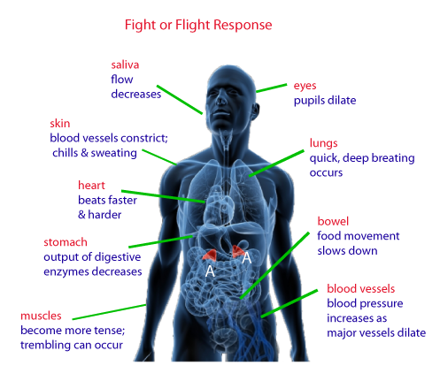
What happens in your body
At the same time your brain sends out a signal to release chemicals called ‘neurochemicals’ into the body to move it into action to help you survive.
Your breathing gets faster and your heart speeds up pumping blood away from the systems it does not need to use such as your stomach and bladder which will make you feel sick and need the toilet, to your muscles ready to defend you or help you escape.
Then once the danger is over and you are safe the alarm system switches off. This can take up to 50 mins.
Notes:
For people with anxiety, this happens a little too much. An anxious brain is an overprotective brain. It does exactly what healthy, normal brains are meant to do, but more often. What this means is that people with anxiety tend to overgeneralise – their brains and their bodies respond to things as though they are dangerous or threatening, even when they aren’t.

Slide 14
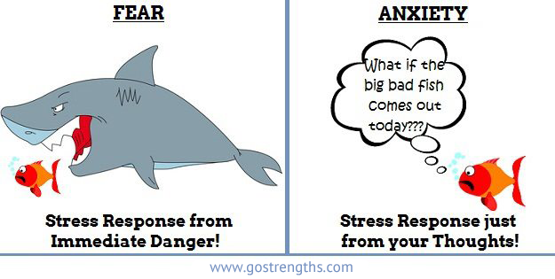
Sometimes things can go a bit wrong…..
The worry alarm system is there to protect us but sometimes we worry even when we are not in any immediate danger.
Sometimes the alarm system is set off by thoughts about the future, ourselves or how we see the world around us.
What starts off as a small worry can grow and grow until the brain becomes overwhelmed and switches on the worry alarm system which triggers the Fight or Flight response.
Notes:
Think of a smoke detector: it is there to warn you if there is a fire but sometimes it can go off for no reason.

Slide 15
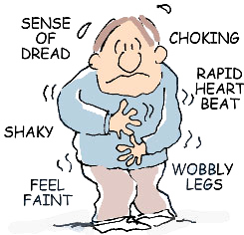
False Alarms….
The thing is if there is no actual danger to run away from there is nowhere for all those chemicals to go.
They can end up staying in your body and could make you feel
ANXIOUS
The longer the emotion is allowed to last the stronger it gets and it can make you feel unwell.

Slide 16
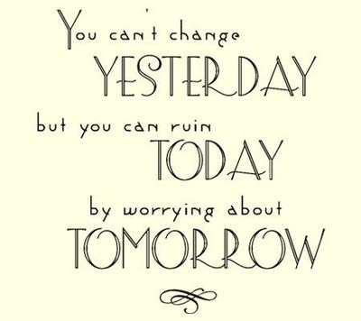
Factors that can contribute to Anxiety
Sometimes we can experience false alarms when we think we are in danger, feel out of control or when our worry thoughts take us into the unknown future.
We can also experience anxiety as a result of:
changes in our brain chemistry
how our brains are wired genetically
as a result of what is going on in our environment
Notes:
Its normal to feel anxious about specific life events such as wanting to do well in an exam, or worrying about someone you love, or feeling a bit nervous about facing a new social situation or having a realistic fear about a dangerous place, object or situation.
ASD brain: There could be a link between the anxiety that people with ASD feel and abnormalities in the structure and size of the amygdala – a part of the brain that plays a key role in processing emotions – and how it functions.
Family Link: how our parents manage anxiety might influence how we learn to deal with big emotions
Environment: growing up in environments where there is constant threat of danger (domestic abuse, war zone)

Slide 17

Anxiety Disorders
Anxiety can become a problem when it allowed to go on for a long time and it stops us living and stops us doing the things we enjoy.
As many as 1 in 6 young people will experience an anxiety problem at some point and fewer will be diagnosed with anxiety disorders.
Anxiety problems can make it difficult to concentrate in school, to remember information, to stay focused, to sit still, to bounce back from challenges, to socialise, to eat and to sleep.
Notes:
Anxiety is a problem
When we are constantly distressed
Avoiding situations
Having seemingly out of the blue panic attacks
Having irrational fears about situaitons where there is no threat/danger
Having reaoccurring nightmares and flashbacks

Slide 18
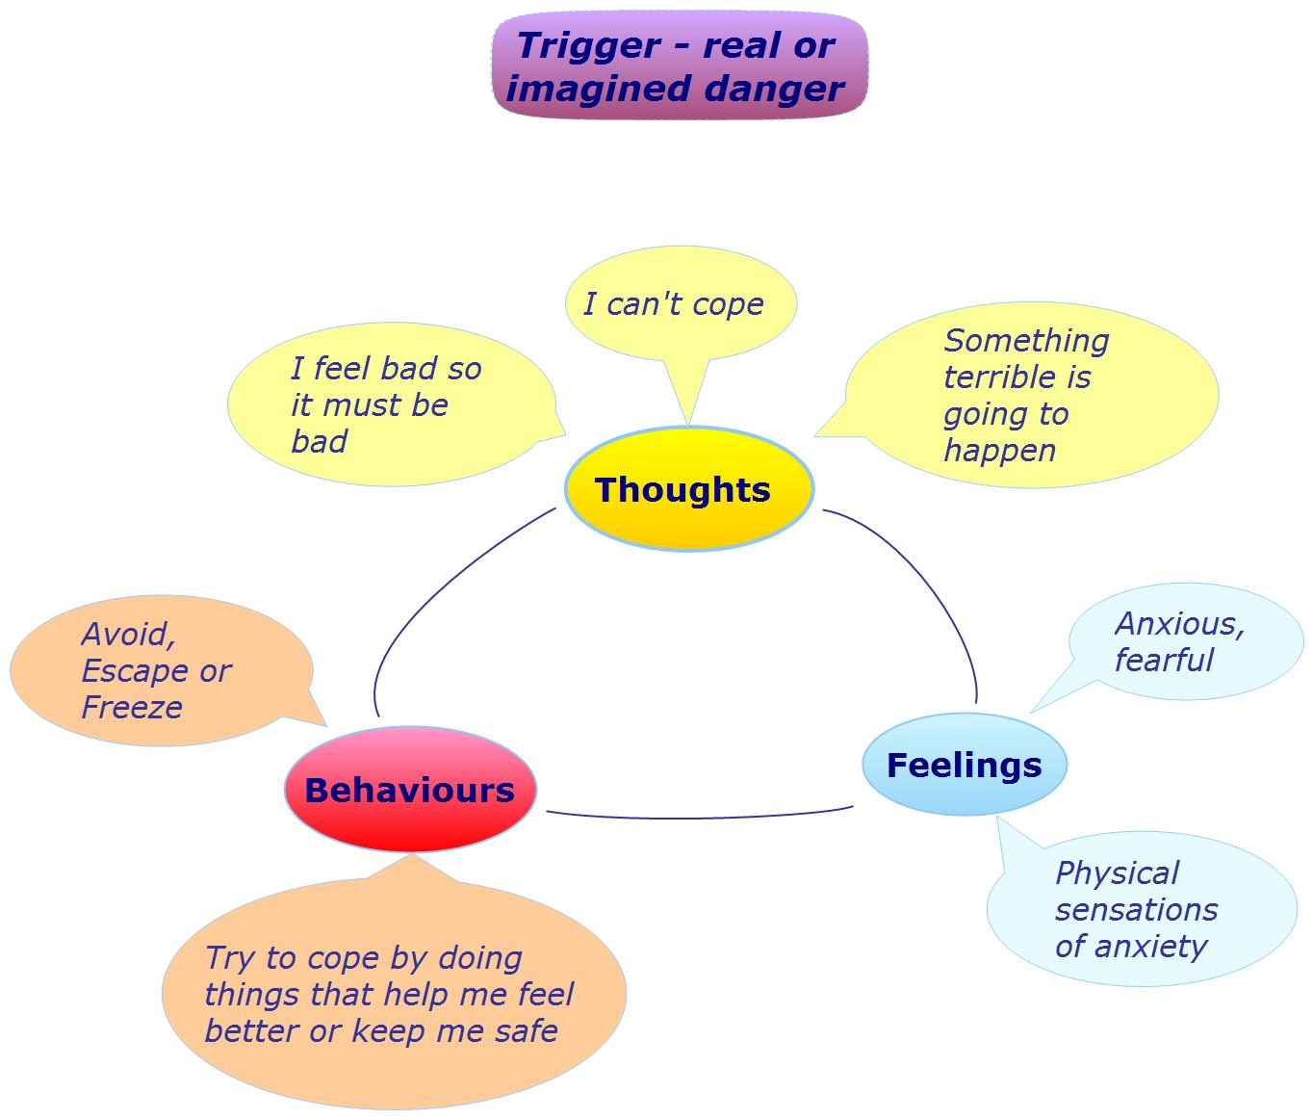
Cognitive Behavioural Therapy (CBT) Model of of Anxiety
Notes:
If we think and see our world and those around us as scary and threatening, the thoughts and beliefs will feed into the feeling of anxiety.
This in turn triggers a ‘fight/flight’ response in our bodies.
This survival response makes us behave in ways that we have learnt will protect us from and get us out of danger.
How we choose to behave can be helpful or unhelpful.
It can get us out of danger or increase our risk of hurting ourselves and/or others
We can choose how to react and behave

Slide 19
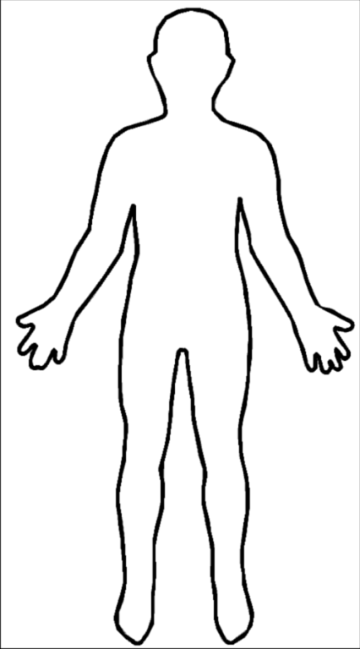

Learning to listen to our bodies
Our bodies react in exactly the same way whether there is an actual danger/threat or if the worry comes from our thoughts.
Recognising the warning signs that our bodies give us can help us in taking the first steps to switch off the worry alarm.
Think back to the last time you felt anxious, can you recall where you felt the emotion in your body?
Notes:
The body has two parts to the nervous system:
Sympathetic which switches on the fight and flight response
Parasympathetic with calms everything down
We cannot stop the sympathetic switch from coming on but we can activate and control the parasympathetic by making our mind aware of what is going on.

Slide 20
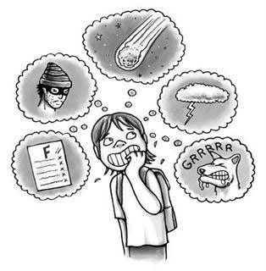
What triggers your worry alarm?
Think back to the last time you felt worried.
What made you feel anxious, worried, scared and/or frightened?
Was it one big thing or lots and lots of little things?
What sorts of things does your child worry about?

Slide 21
Common triggers for anxiety for ASD children
Children may not have the words to tell you what they are worried about. You may have to investigate and find out for them:
changes in routine – for example, when a weekly piano lesson gets cancelled because the teacher is sick
changes in environment – for example, when some furniture gets moved, there’s new play equipment at the local park, or you move house
unfamiliar social situations
sensory sensitivities– children with ASD might be scared by certain noises or be sensitive to bright lights, specific flavours or food textures
fear of a particular situation, activity or object – for example, sleeping in their own bed, going to the toilet, balloons or vacuum cleaners.

Slide 22
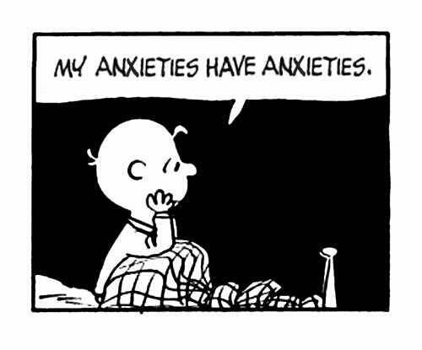
Some common worry thoughts: what if I……
Fail
Not good enough
Not safe
Not loved
Am powerless
Not wanted
Not liked by other children
Am hungry/tired
Do not belong in the family
Am embarrassed/shamed
Get hurt
Lose something
Have something important taken away
Fear change
Experience Information overload

Slide 23
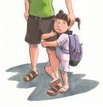
Unhelpful ways of managing Anxiety
The physical symptoms that come with anxiety can be unpleasant and can make us feel unwell.
In order to avoid the feeling we sometimes develop patterns of behaviours which can in themselves make the problem worse and end up becoming the PROBLEM.

Slide 24
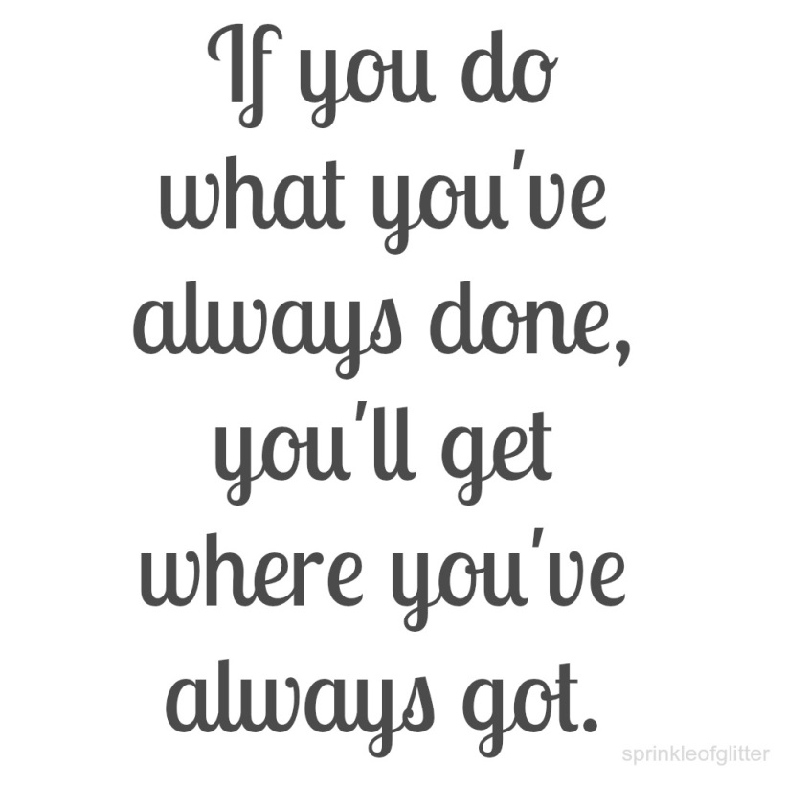
Being aware of what you do to cope with anxiety
What do you do when you feel anxious?
Do you:
do you freeze?
run away and avoid?
get angry and hit out at others?
What else do you do?
How is this working out for you as a coping strategy?
Have you become trapped in a pattern of behaviour every time you feel anxious?
Notes:
Table top discussion

Slide 25
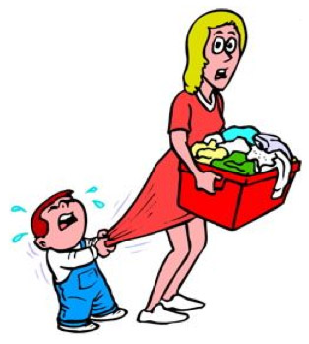
Unhelpful Patterns of Behaviour
Children and young people communicate their worries and try to manage their worries in many ways:
Complaining of feeling ill, tired, not sleeping or eating
They may find it difficult to separate from their parent
Avoiding school or a certain situation
Avoiding talking in public
Others may develop rituals and repetitive patterns of behaviour
Meltdowns or tantrums or panic attacks ‘out of the blue’
Notes:
Children with autism spectrum disorder (ASD) feel many of the same worries and fears as other children.
But when children with ASD get worried or anxious, the way they show their anxiety can look a lot like common characteristics of ASD – stimming, obsessive and ritualistic behaviour and resistance to changes in routine

Slide 26

Making Change Happen
Sometimes its really difficult to change how we think or see ourselves, others and the world around us
By changing what we do, we can change how we think and feel
It is important to remember: we do not have the power to change others but we do have the power to change ourselves by choosing how we respond and what we do in certain situations

Slide 27
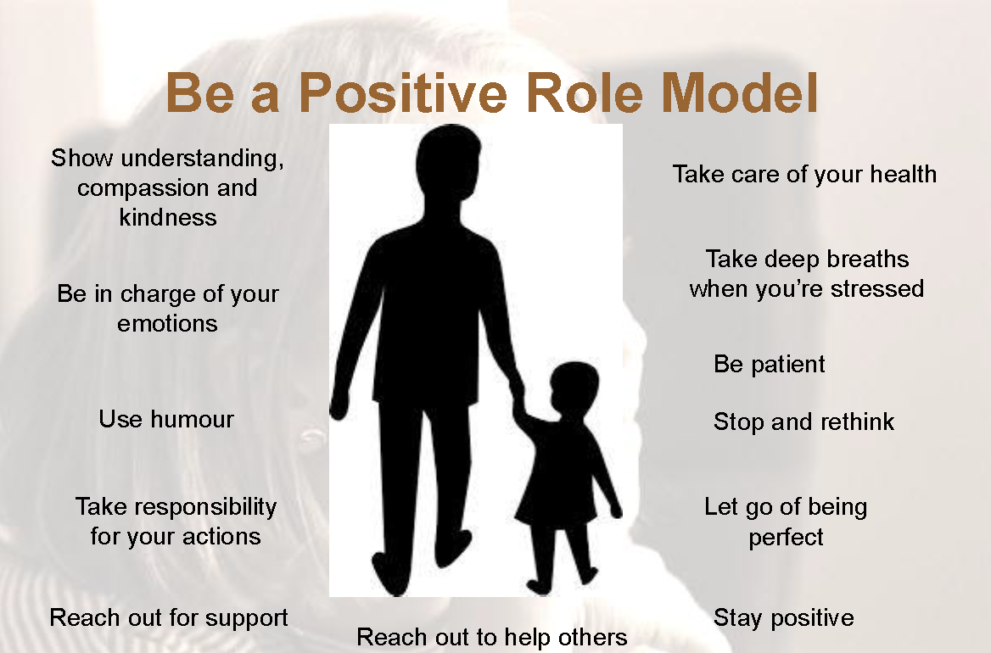
Being a role model
Children learn how to cope with difficult situations by watching what other people (their role models) do and listening to what those people say.
It is important to be mindful of how you act and what you say in situations that you find anxiety provoking as your children will mirror you.

Slide 28

Looking for Solutions
If it works for you and is helpful, carry on doing it
If it does not help or makes things worse, stop doing it and try something else instead!
Remember, changing patterns of behaviour takes time and hard work.
When situations get tough, who can you ask for help?
Remember there are people around you who can help you if you ask.

Slide 29
Four Steps to Help Children
1. Practicing Relaxation
& Breathing
2. Problem Solving Skills
3. Challenging worries
4. Manage unwanted behaviour
Notes:
Nice guidelines recommend certain pathways of care for anxiety and these are CBT principles these include sessions on understanding anxiety, relaxation training, challenging worrying thoughts and managing unwanted behaviour.

Slide 30
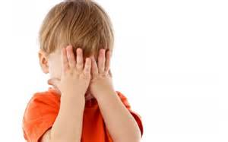
How to manage your child’ anxiety
As soon as you notice the warning signs, say the child’s name
Ask them to:
STOP
ACKNOWLEDGE AND VALIDATE HOW THE CHILD IS FEELING. NAME THE EMOTION FOR THEM
REMAIN CALM AND CONTAINED IN THE WAY YOU REACT AND HOW YOU COMMUNICATE
ENCOURAGE THE CHILD TO REFOCUS THEIR ATTENTION. GIVE CLEAR AND CONCISE INSTRUCTIONS AND TIME TO CALM DOWN
REFLECT AND LEARN FROM THE EXPERIENCE- LOOK FOR SOLUTIONS TOGETHER
Notes:
Say the child’s name
Make eye contact and come down to their eye level if possible
Acknowledge and validate- name the emotion:
I can see that you are feeling worried
You seem really worried about…….
Contain:
Speak in a calm, soothing tone. Keep communication clear and concise. Listen and observe
Give clear instructions of the behaviour you do want to see: I want you to stop; I want you to go outside and run around for ten minutes.
Set limits in a supportive way: ‘ I know you are upset about…..but it is not ok to yell’
Re-direct their attention to another activity and give them time to calm down.
Reflect: use open ended questions:
When, where, how, why
Seek clarification and summarise
Think of solutions to deal with the problem together
‘what would help you to be brave?
What do you need to do next to beat the worry monster?

Slide 31
Things to avoid…..
Avoid dismissing a child’s emotions: saying ‘don’t be scared’ can lead the child to think they are wrong and bad for feeling that way
Avoid lying to avoid an emotional reaction: ‘ it won’t hurt’ when it will may lead to a sense of distrust and increase the emotional response
Avoid shaming a child for their emotions: teasing a child may lead to a sense of shame and undermines confidence
Avoid ignoring a child’s emotions: this may tell the child that their emotions are not important and limit opportunities to learn new ways of managing emotions

Slide 32
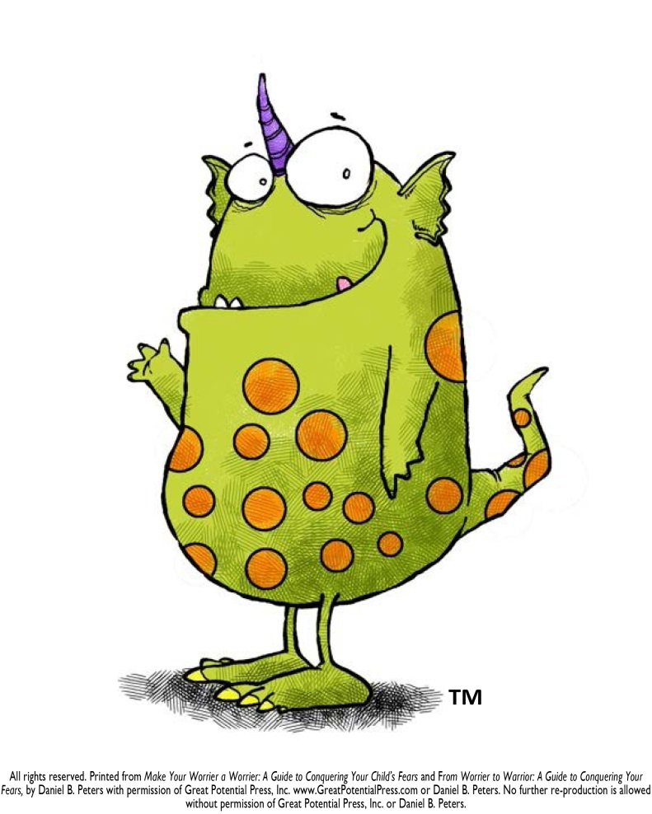
Bringing the anxieties to life
Ignoring your worries doesn’t help but bringing the worry to life and talking about it like a character can help especially for younger children.
Help the child to create their own worry monster
‘The worry monster lives in the old brain that is responsible for keeping us safe when we are in danger. Of course, sometimes he can get confused and a bit out of control. When that happens we need to stop and talk some sense into him. What do we need to tell him to help him calm down?’

Slide 33
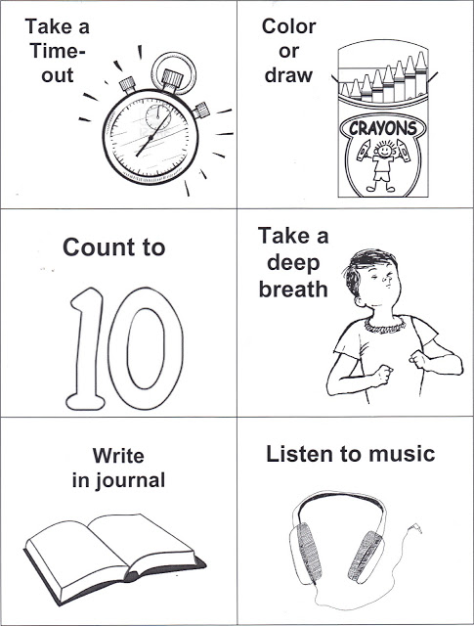
Make a checklist
What do trained pilots do when they face an emergency? They refer to a checklist. Even with years of experience a pilot will refer to a checklist because when you are faced with danger you cannot think straight.
When we feel anxious we can get overwhelmed and not be able to think clearly.
Drawing up a checklist of things that you know help you to calm down can be really useful.
You can try out new techniques and evaluate how helpful they are for reference.
Notes:
Make a visual checklist
Display it
Practice the strategies when everyone is calm

Slide 34
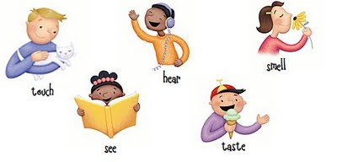
Some suggestions for your calm plan
HEAR
Sing a song
Play a musical instrument
Count your breath
Listen to music
TOUCH
Have a bath
Give someone a hug
Stroke your pet
Brush your hair
Wash your face/hands
Apply cream
Paint your nails
Rub a smooth stone
Play with clay/dough
TASTE
Have something to eat
MOVE ABOUT
Jumping jacks
Run around
Go for a walk
Dance
Do yoga
Squeeze a ball
Ride a bike
DO
Write your thoughts in a book
Colouring in
Play a game
Have a laugh
Make a cup of tea
Bake a cake
Rip up some paper
Punch a pillow
SEE
Go outside
Watch a film
watch TV
read a book/magazine
watch a snow globe
draw a picture
blow some bubbles

Slide 35
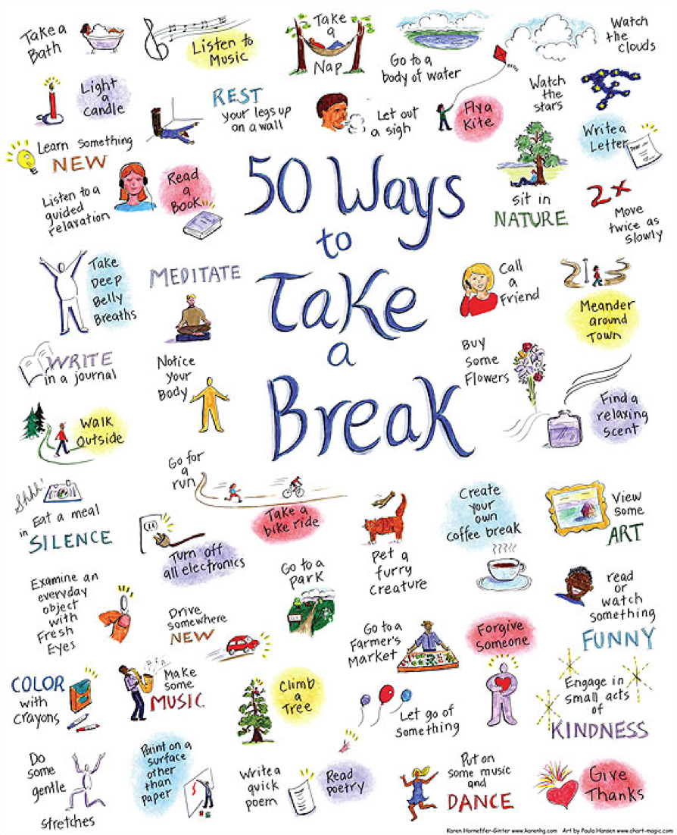

Slide 36
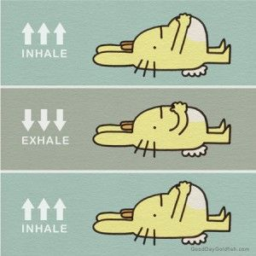
Being Mindful
Research shows that bringing our attention back into the present using mindfulness techniques can be helpful at moving us from ‘what if’ to ‘what is’
One simple way of doing this is to refocus your mind’s attention onto your breathing for a few minutes
Alternatively going for a walk, sitting in a car, listening to music, kick a football outside, using visualisations……
Notes:
You may not know this but human beings to a lot of time travelling. In fact mentally we spend a great deal of time thinking ‘what if’ (thinking about the future) and ‘if only’ (thinking about the past)
For someone with anxiety this type of thinking can make their anxiety grow out of control

Slide 37
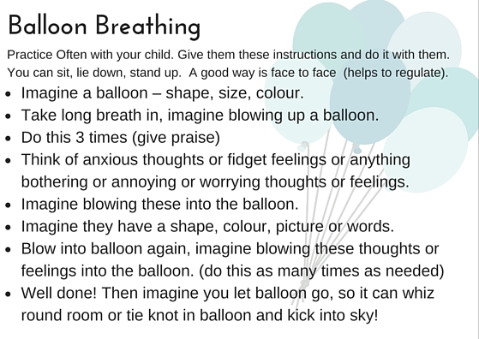
Notes:
Lots of free apps out there:
Headspace
Therapist aid website
National autistic website

Slide 38

Using mindfulness to calm you
  VISUALISATION EXERCISE
  Go somewhere quiet or just look out the window & let your mind relax.
  Take your awareness to your breath. Focus on the movement of the breath as you inhale and exhale deeply
  Think of your Happy Place & let your mind take you there……

Slide 39
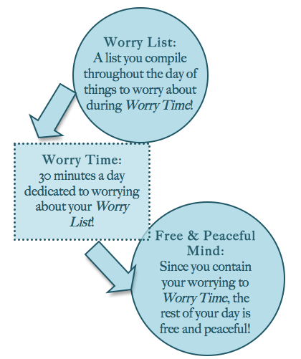
Allow yourself time to worry
As you know, telling yourself or your child not to worry only makes you worry more!!
Allowing your child to worry openly in limited doses can be helpful
Create a daily ritual of worry time. Allow 10 to 15 minutes when you can openly talk and write down your worries and learn to let them go
When the time is up, close the book or box for the day and say ‘goodbye to the worries’

Slide 40
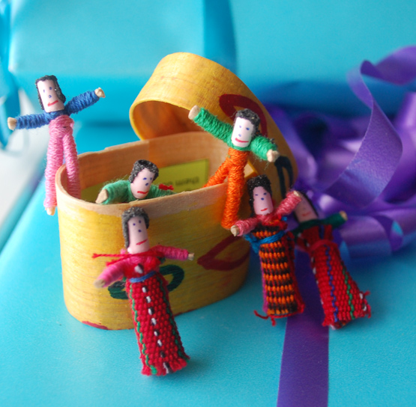
Suggestions to help challenge your worries
THOUGHT DIARY – write down worries and fears and contain to a book you can just shut and close off your worries and fears
CHALLENGE WORRIES Make a list of all the things that worry you. Write positive challenging statements next to your worry thoughts – “What would you tell your best friend to do”; is it a ‘fact or a belief?’
FINDING SOLUTIONS using worry tree
TALK to someone – a problem shared is a problem halved.
Tell the Worry Monster that he cannot beat you!!

Slide 41
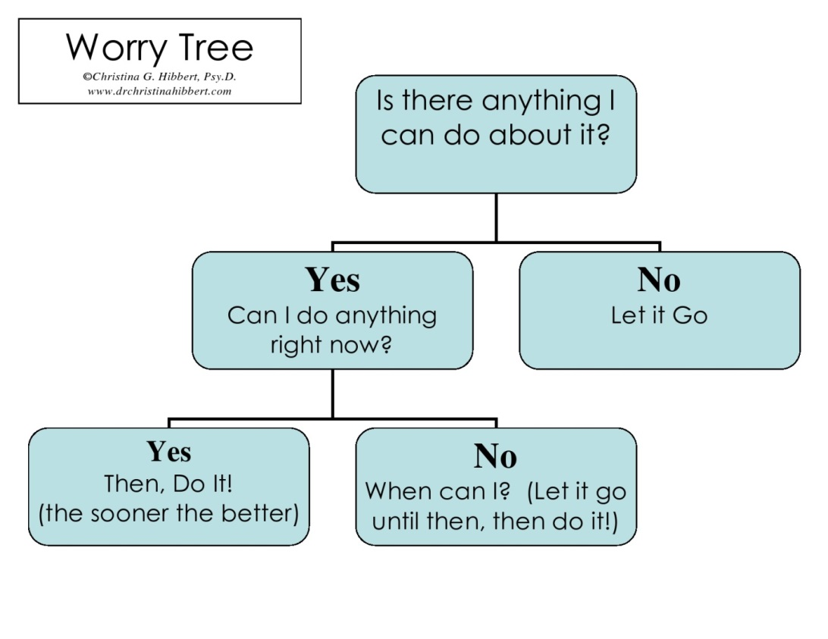
An example of a Worry Tree

Slide 42
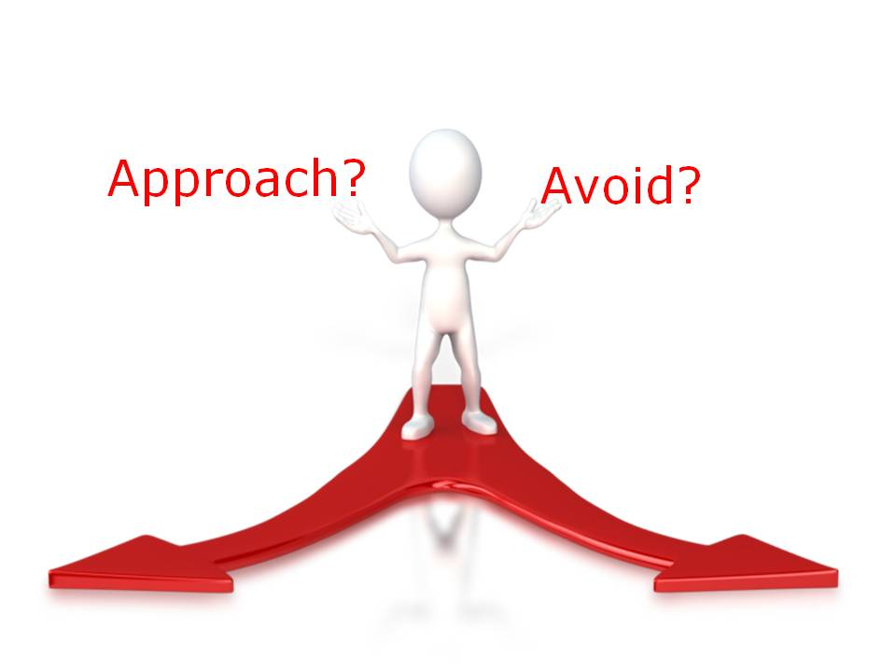
Avoid Avoiding……
Do you want to avoid social situations, going to school, planes, dogs, basically anything that makes you feel anxious?
Of course you do! That’s natural. The fight/flight response tells you to escape the situation that you believe to be threatening or dangerous.
Unfortunately in the long run, avoidance makes the anxiety worse.
Notes:
And if we avoided every new experience we would never learn and develop.

Slide 43
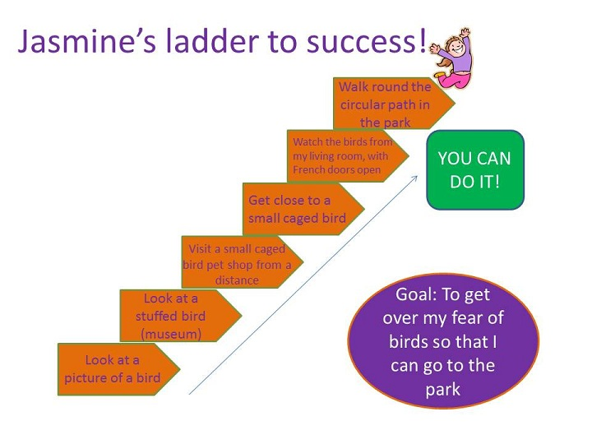
Laddering
Work with the child and make a plan together:
Break the worry down into manageable chunks and use gradual exposure to reach a goal.
Think of laddering as practicing and rehearsing a new skill.
Reinforce the learning with praise and rewards
Notes:
Start with a situation or thing that causes your child the least anxiety. Sometimes you might need to put your child in this situation a few times until he feels comfortable with it.
Move on to another situation that makes him feel a bit more anxious. Again, go through it a few times until he can handle it.
Gradually move through more and more challenging situations
When using the stepladder approach for anxiety in children, it’s important to encourage your child by giving lots of praise for achieving each step on the ladder.
You can also use rewards as incentives for your child to move forward. Rewards might include an extra book in the evening, more cuddle time with you, or a trip to the park. Make sure the reward matches the degree of difficulty – for example, don’t give a small reward for the most difficult step.
Note: the stepladder approach can be used with children of all ages. Grown-ups can use it too.

Slide 44
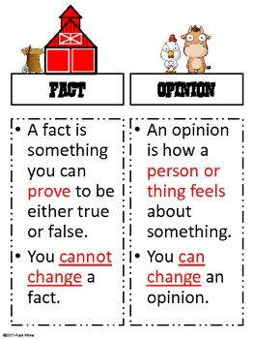
Challenging unhelpful Thoughts
Remember, worry is the brain’s way of protecting us from danger
To make sure we are really paying attention, sometimes the brain over exaggerates the object of worry.
One worry suddenly grows and grows!!
The best way to deal with distorted thinking is to check out whether it is accurate thinking.
Is it a fact or an opinion?

Slide 45
Challenging your thoughts using the 3 ‘Cs’
Catch your thoughts: imagine your thoughts floating in a bubble above your head. Now catch your worried thought. What does it say? (no-one at school likes me)
Collect evidence to challenge your thought: Feelings are not facts: ‘ I had a hard time finding someone to sit with me at lunchtime but Claire and I do our homework together. She is my friend’
Challenge your thoughts: lets look at the evidence. Is it a fact or an opinion?

Slide 46
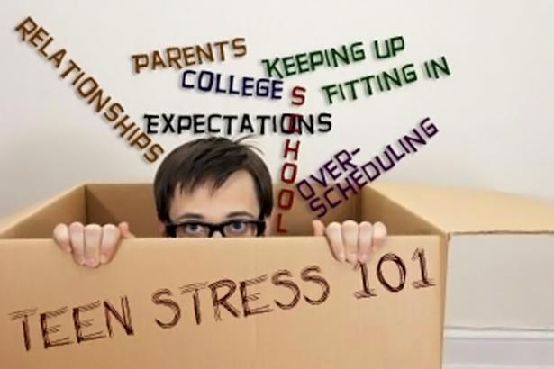
When to be concerned
When there’s been a change in their normal behaviour, its impacting on their functioning & it has been persistent for a period of time.
Avoiding certain situations
A drop in academic performance
Change in sleep pattern
Change in appetite/eating patterns
Weight loss or gain in a short period of time
Complaining of physical symptoms
Not caring about self, others and things
Relationship or Friendship difficulties
Lack of motivation
Low self esteem

Slide 47
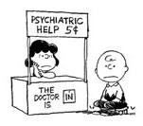
Where to go for Help
Its Ok to ask for help and advice. Here are a few suggestions of where you can go to get help:
School
Children’s Centres
Health Visitors
Primary Mental Health Worker
GP
CAMHS

Slide 48
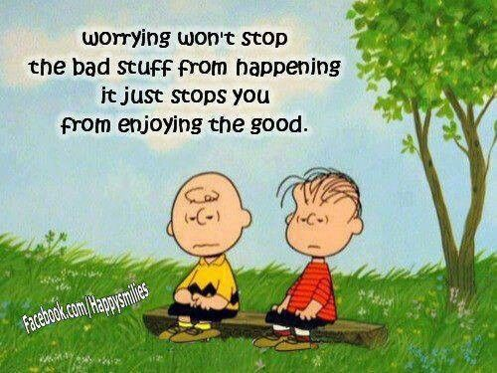
Summary
Regain control of anxiety. Do not allow anxiety to control you
Keep the issue in proportion
Feel the fear and face it anyway
Use coping strategies : they WILL work, just keep practicing
Have a ‘calm plan’ prepared
Enjoy life; do not waste your life worrying it away!
Know where to go to ask for help if you need it

Slide 49
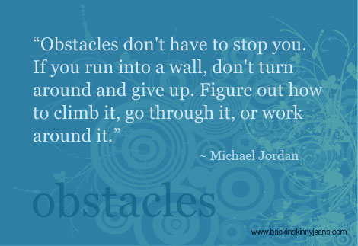

Slide 50
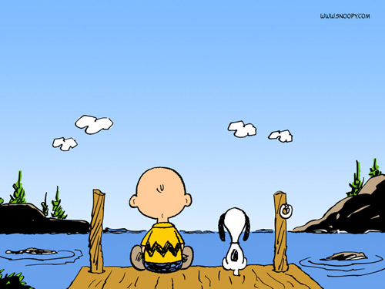
Questions
and
Answers

Slide 51
Useful Websites and Contacts
Phone Childline: 0800 11 11
Phone Samaritans: 08457 90 90 90
Or visit for more information:
www.mentalhealth.org.uk
Young Minds
www.youngminds.org.uk
Phobics Society
www.phobics-society.org.uk
Get self help
www.getselfhelp.org.uk
ASD emotional regulation website: https://www.middletownautism.com/fs/doc/publications/mca-bulletin-8.pdf
http://psychology.tools/download-therapy-worksheets.html
http://raisingchildren.net.au/articles/autism_spectrum_disorder_anxiety.html/context/1390

Slide 52
Book References
Helping Your anxious Child by Rapee, Spence, Cobham and Wignall
What To do When You Worry Too Much – A Kids Guide To Overcoming Anxiety
By Dawn Huebner
What To Do When You Grumble Too Much – a Kids Guide to Overcoming Negativity
By Dawn Huebner
1,2,3 Magic by Thomas Phelan book/DVD resource which can help remind everyone of useful age appropriate strategies when trying to encourage young people to make wise choices in their behaviour especially useful for parents of children aged 2 to 12; learning to manage troublesome behaviour, encourage good behaviour, and strengthen the parent-child relationship
Overcoming Your Child’s Fears and Worries a self-help guide to using CBT Techniques by Cathy Creswell and Lucy Willetts
Overcoming Your Childs Shyness and Social Anxiety a self-help guide to CBT techniques by Cathy Creswell and Lucy Willetts
Relax Kids Aladdin’s Magic Carpet by Marneta Viegas
The Whole Brain Child by Dr Daniel Siegel
The Brain by David Eagleman
The Chimp Paradox by Steve Peters
The Huge bag of worries by Virginia Ironside

